Slide 1
Web Assembly
Is it the future of JavaScript or will JavaScript fade away?
John Mandia
@jmandia/@waxidotio
July 2018

Slide 2
JavaScript
Created in 10 days in May 1995 by Brendan Eich
ECMA-262 Timeline
V1 1997
V2 1998
V3 1999
V4 XXXX
V5 2009
V5.1 2011
V6 2015
V7 2016
V8 2017
V9 2018

Slide 3
The Introduction of Automatic Updates
Year | Internet Explorer | Edge | Firefox | Chrome
2001 | 6 | - | - | -
2004 | 6 | - | 1 | -
2006 | 7 | - | 2 | -
2008 | 7 | - | 3 | 1 (Webkit)
2009 | 8 | - | 3.5 | 3
2011 (March) | 9 | - | 4 | 10
2013 (Oct) | 11 | - | 24 (ESR) | 30 (Blink)
2015 (March) | 11 | 0.10 | 36 | 41

Slide 4
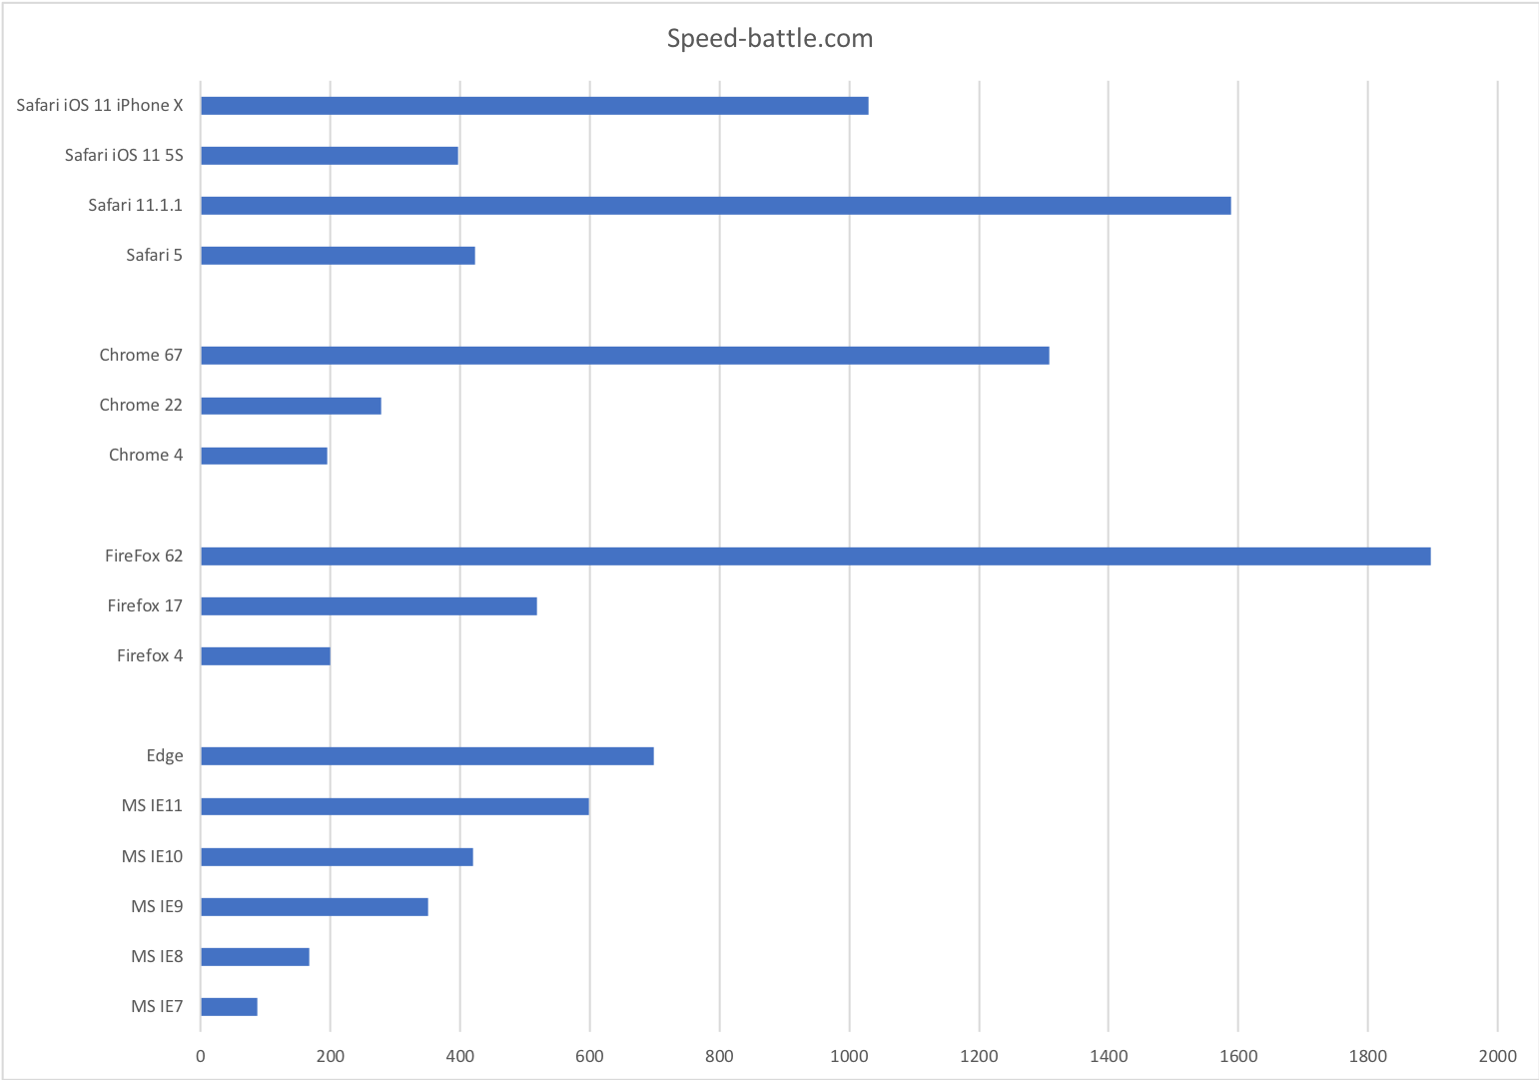
If anyone knows of a site that has the history of browser engine JavaScript performance
against the same test and hardware please let me know

Slide 5
https://speedcurve.com/blog/web-performance-page-bloat/

Slide 6
Google
Native Client

Slide 7
”NPAPI has shown its age. Plug-ins are a source of performance problems, crashes, and security incidents for Web users”
https://blog.mozilla.org/futurereleases/2015/10/08/npapi-plugins-in-firefox/

Slide 8
asm.js
“asm.js, a strict subset of JavaScript that can be used as a low-level, efficient target language for compilers. This sublanguage effectively describes a sandboxed virtual machine for memory-unsafe languages like C or C++. A combination of static and dynamic validation allows JavaScript engines to employ an ahead-of-time (AOT) optimizing compilation strategy for valid asm.js code.”
http://asmjs.org/spec/latest/

Slide 9
OpenSCAD is software for creating solid 3D CAD objects
Forked in 2012 with asm.js support
Fork of OpenScad no longer exists but the forked dependencies (which was the
hard bit) can be found here: https://github.com/marcosscriven/cgaljs

Slide 10
What does JavaScript performance look like today?
Lin Clark: https://hacks.mozilla.org/2017/02/what-makes-webassembly-fast/

Slide 11
WebAssembly is a way of taking code written in programming languages other than JavaScript and running that code in the browser. It is a new low-level, assembly-like language that runs efficiently on the existing web platform and is backward-compatible with its precursor, asm.js.
Announcement June 2015: https://brendaneich.com/2015/06/from-asm-js-to-webassembly/ February 2018 W3C public draft published (MVP): https://webassembly.github.io/spec/
Image from Lin Clark : https://hacks.mozilla.org/2017/02/where-is-webassembly-now-and-whats-next/

Slide 12
How does WebAssembly compare to JavaScript Performance?

Slide 13




Slide 14
Performance

Slide 15
https://blog.scottlogic.com/2017/10/17/wasm-mandelbrot.html

Slide 17
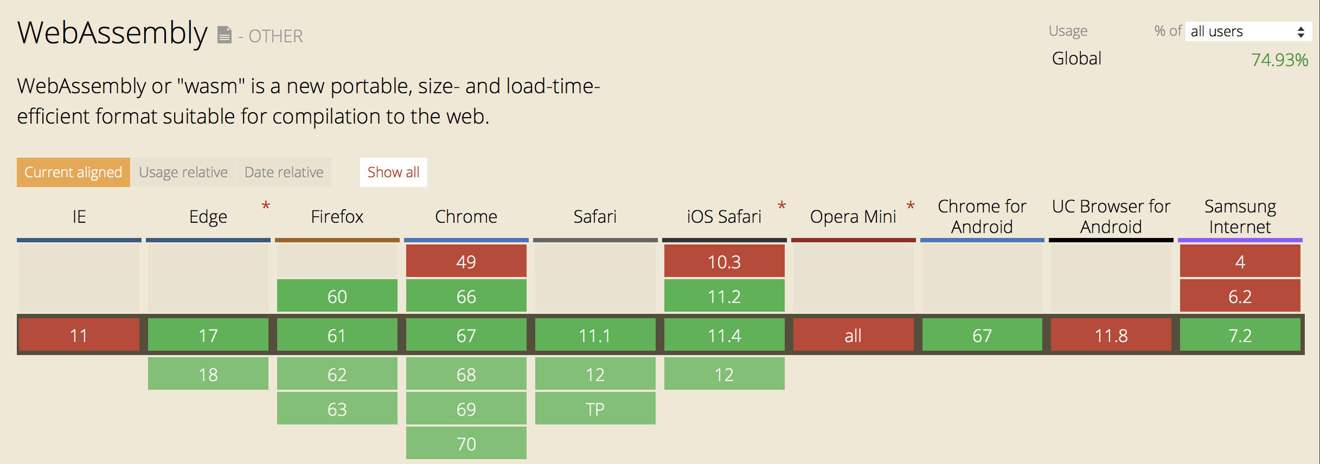
Your Target Browser

Slide 18
Missing Features
Garbage Collector (make use of the garbage collector provided by the browser)
Threading (if you want to execute a function and not have it block do it via a web worker)
Exception Handling not specified as part of the web assembly spec
Host Bindings (e.g. working directly with the DOM)

Slide 19
Your Target Language
And
How Mature Is The Support
C/C++ - Emscripten http://kripken.github.io/emscripten-site/
TypeScript – AssemblyScript https://github.com/AssemblyScript/assemblyscript
C# - Blazor https://github.com/aspnet/Blazor
Java – TeaVM http://teavm.org
Rust https://hacks.mozilla.org/2018/03/making-webassembly-better-for-rust-for-all-languages/
More Options: https://github.com/appcypher/awesome-wasm-langs

Slide 20
Developer Tooling
Debugging Support – Source Map support
Profiler Support – In the browser
Developer Tooling

Slide 21
Blazor Source Map Support Coming

Slide 22
So will JavaScript fade away?
I think it is the future of JavaScript as it will empower developers to extend browser functionality using wasm code provided by others
It gives JavaScript developers the option of learning new languages and using them alongside a language they are familiar with

Slide 23
Will another language dominate the web?
There will be wasm based frameworks across languages but JavaScript will still have critical mass for some time to come
JavaScript may also find a place (for some) as the view layer of an application with services and business logic implemented in Web Assembly

Slide 24
When to use it
You need some functionality that isn’t available or is slower with JavaScript but can be provided via Web Assembly
You are migrating a large project to the web and a lot of the business logic can be moved to Web Assembly and shared
You have a team that knows a supported Web Assembly language really well but doesn’t know JavaScript
You want to learn more and experiment

Slide 25
What next?
http://webassembly.org
Lin Clark: A cartoon intro to WebAssembly https://www.youtube.com/watch?v=HktWin_LPf4
Build the future of the web with WebAssembly and more https://youtu.be/BnYq7JapeDA
https://webassembly.studio – An easy way to experiment with web assembly
https://learn-blazor.com
https://github.com/rustwasm/team
https://blog.figma.com /webassembly-cut-figmas-load-time-by-3x-76f3f2395164
WebAssembly and the Death of JavaScript https://youtu.be/pBYqen3B2gc

Slide 26
Questions?

